Slide 1


Roomify
Automated intelligent meeting room bookings
09.03.24

Slide 2

Agenda
INTRODUCTION
Meet Our Team
Roomify Features and Walkthrough
Our learnings and insights
Whats Next
Conclusion

Slide 3
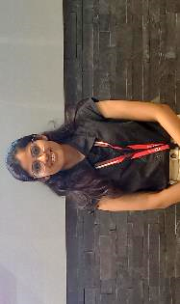
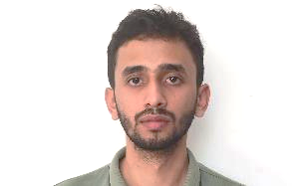


Meet the team Frontend
Tanuja
Javascript
Bilal HTML,CSS & javascript
Saanya
Html,css & javascript
Udaya Sri
Html,css & javascript

Slide 4





Meet the team backend & qa
prashant
Nirupama
Team lead, jdbc, layered architecture
Entity and Relation
Sanket
Ankur
Exception Handling
QA and View
Mahesh
Unit Tetsing

Slide 5

Automated Meeting Room Booking System designed to streamline the process of reserving meeting spaces within a corporate environment.
The system provides a user-friendly interface, developed using HTML, CSS, and JavaScript, to allow employees to search and book meeting rooms according to their specific requirements.
The backend of Roomify, built in Java using JDBC and MySQL, manages all the core functionalities, including user management, room scheduling, meeting organization, and amenity management.
The system provides functionalities to view usage statistics and help in assisting decision making bodies gain valuable insights based on usage of rooms and the system.

Slide 6

Features and walkthrough
Let’s Dive In

Slide 7

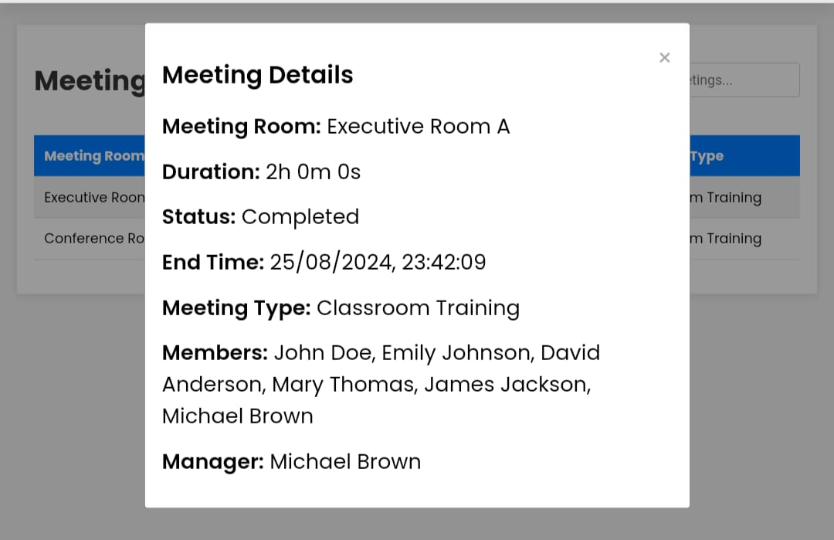
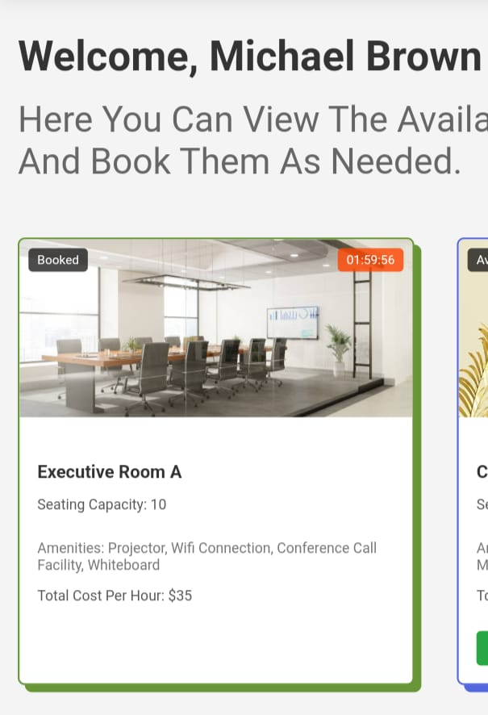
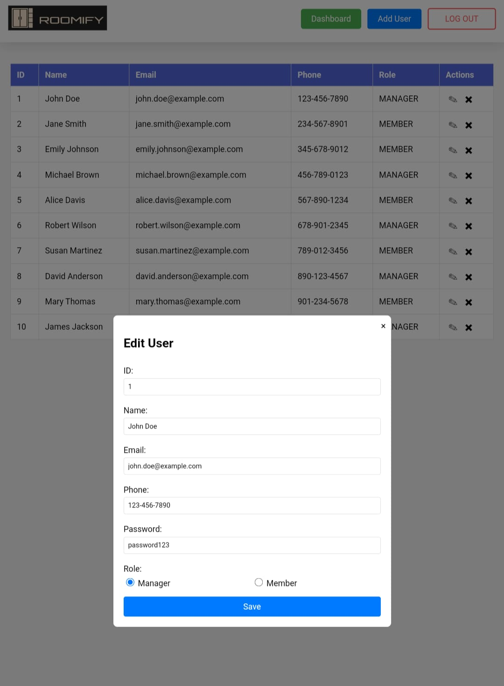
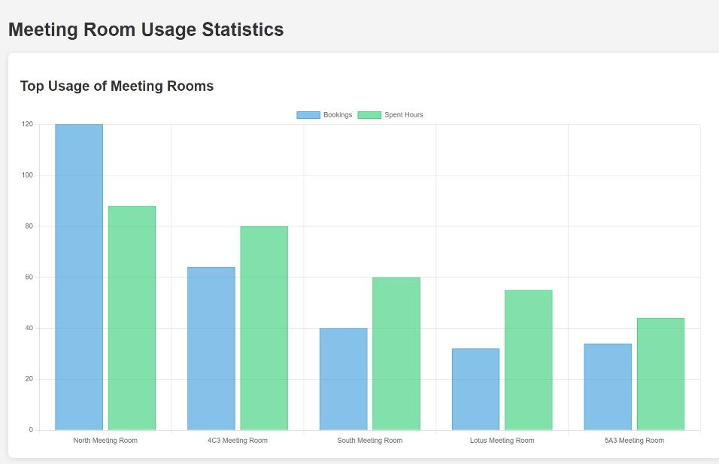
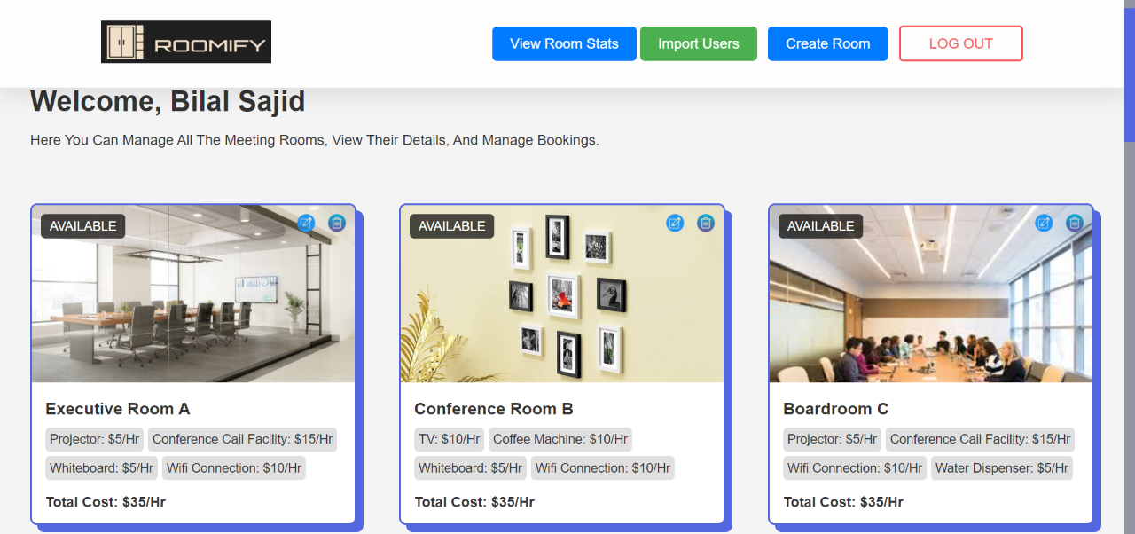
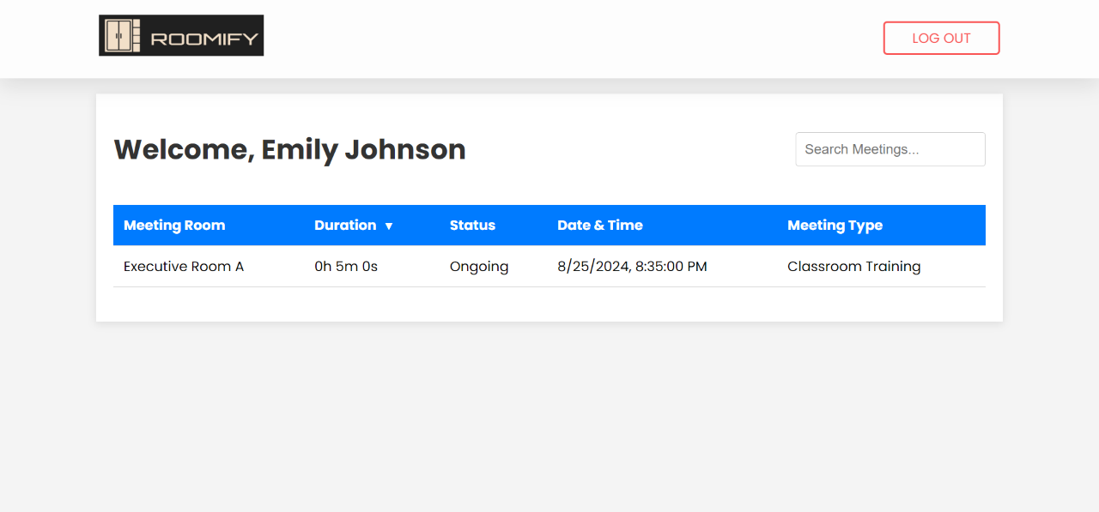
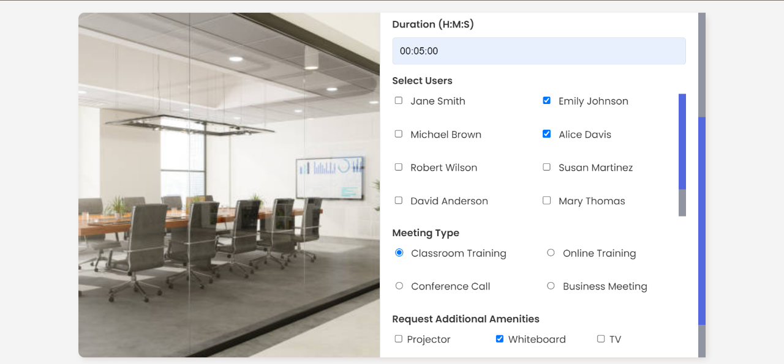
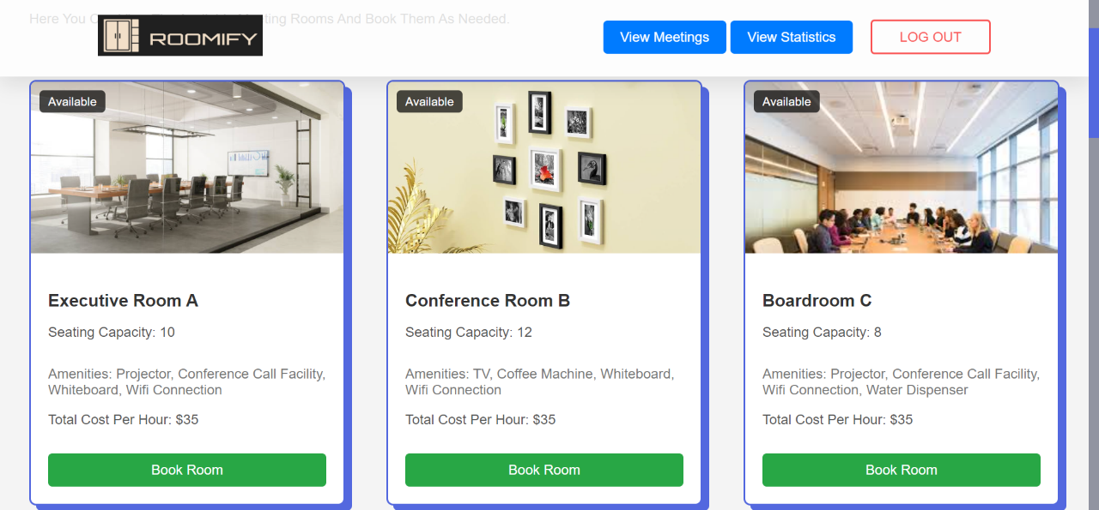
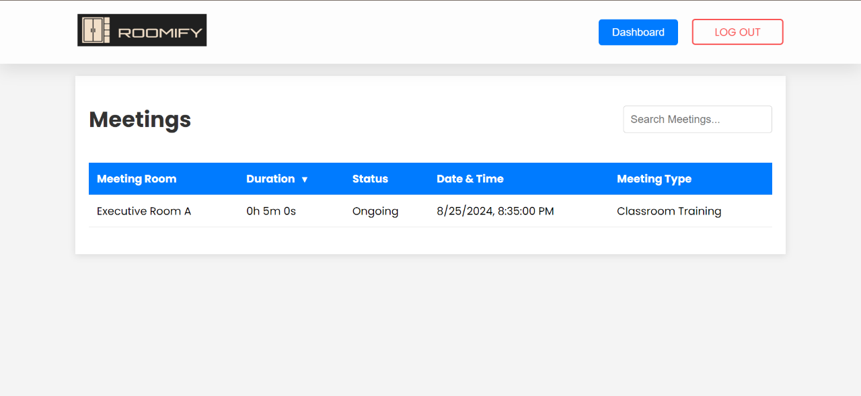
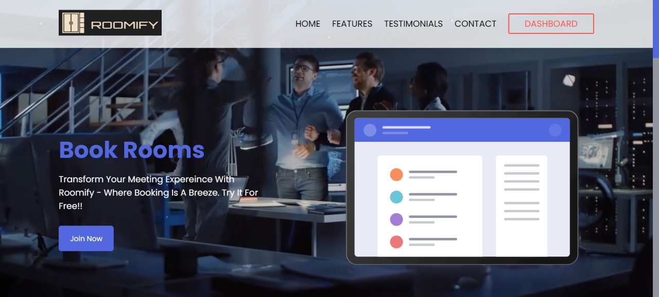
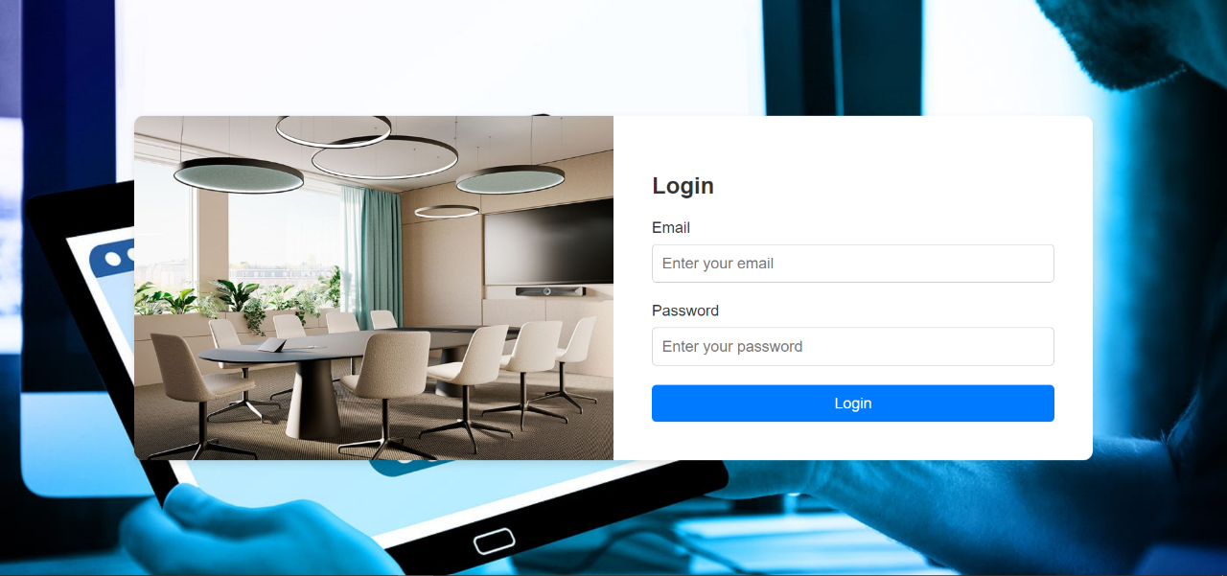
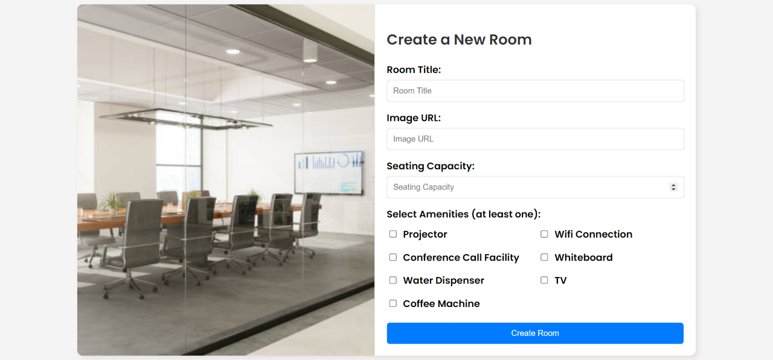
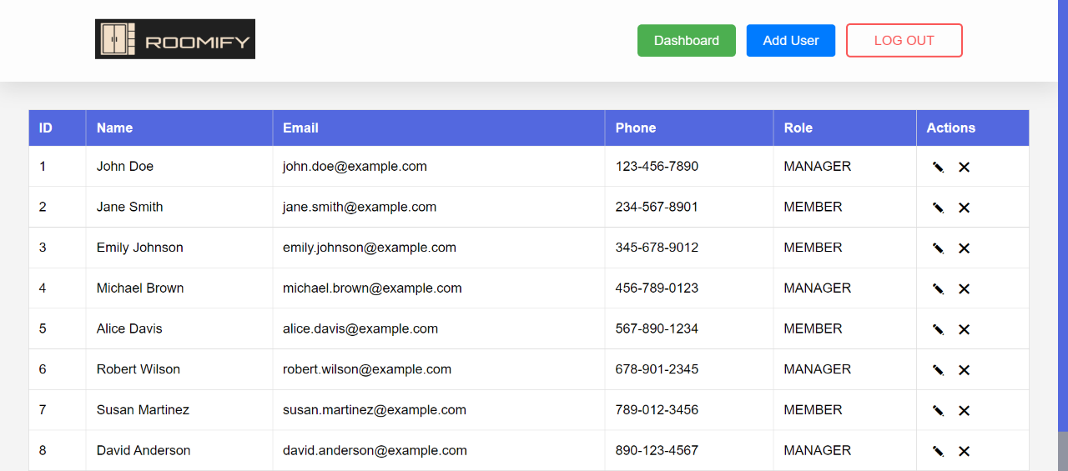
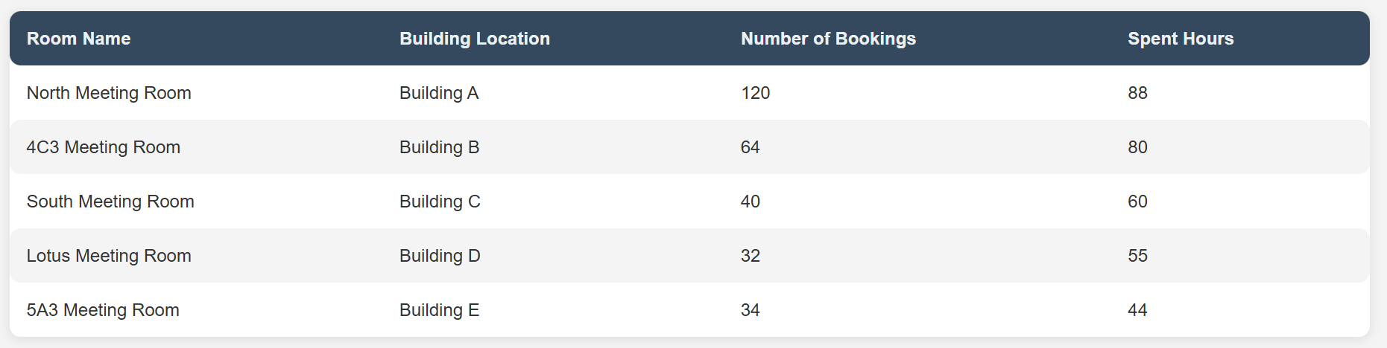
Features and Walkthrough
See how the magic happens!
Easy to use UI
Fluent Meeting Booking Flow
User Management
Room Management
Role based authentication
Statistics Dashboard

Slide 8
A Powerpacked dev team
Our Learnings and insights

Slide 9

Learnings and insights
Learning while building
Technologies Used
Java & JDBC: Developed backend logic and database interactions.
MySQL: Managed data storage for users, rooms, and bookings.
HTML, CSS, JavaScript: Built the frontend interface.
Figma: Created system diagrams for design clarity.
Github: Enabled seamless team collaboration and version control.
Team Learnings
Collaborative Development: Enhanced communication and teamwork, especially in managing code with Git.
Design & Architecture: Gained insights into system design principles and robust error handling.
Technical Proficiency: Improved skills in Java, JDBC, and MySQL, and learned best practices in web development.
Project Management: Learned effective time management and the value of iterative development.

Slide 10

Summary
Enhanced Collaboration
Improved teamwork and communication through version control and shared development practices.
System Design Mastery
Gained proficiency in creating and implementing detailed design diagrams and robust error handling.
Technical Growth
Strengthened skills in Java, JDBC, MySQL, and web development, while learning to navigate and solve complex coding challenges.
Problem solving
Most important outcome of this hackathon was helping us polish our problem-solving abilities.

Slide 11


THANK YOU
Team Autobots

